Slide 1
Python 3

Slide 2
Types of Programming Languages
Compiled:
Ran through program to make a file able to be executable in a certain environment
Doesn’t necessarily need other programs
Can provide faster performance and optimizations
Interpreted:
Ran through a program for it to run immediately
Code is run at time of execution/no need to compile
Convenient for scripting languages

Slide 3
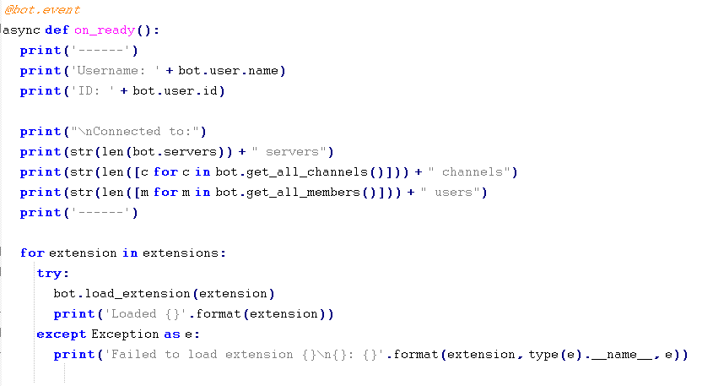
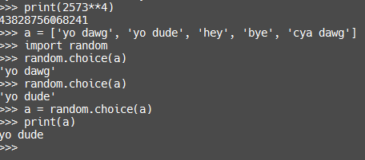
What is Python3?
Python 3 is a scripting language.
A scripting language is an interpreted language
Different from others
Whitespace needed
No semicolons needed

Slide 4
What can you do with Python?
Anything
Games
Calculators
Automated Scripts
Web-based programs
SCIENCE
GUI’s

Slide 5
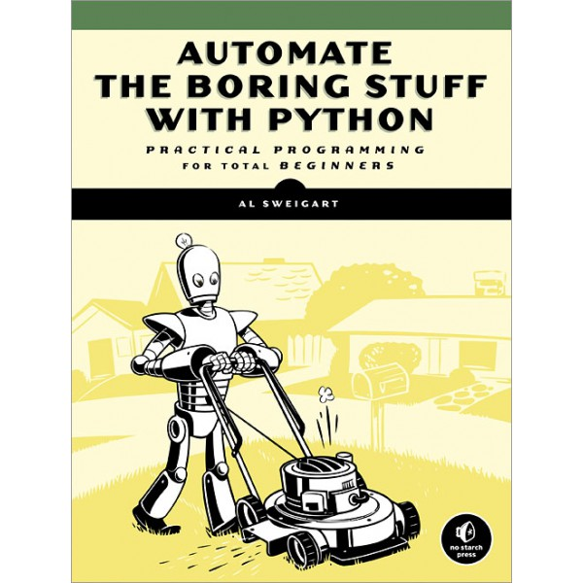
What will we be using to learn Python3?
We will be using a book called ‘Automate the Boring Stuff with Python’
It is updated to python3 and is considered the best learning resource
You can also go on codecademy but they are behind on python versions.
They are on python2 while we are on python3
The book is available on PDF in the google drive.

Slide 6
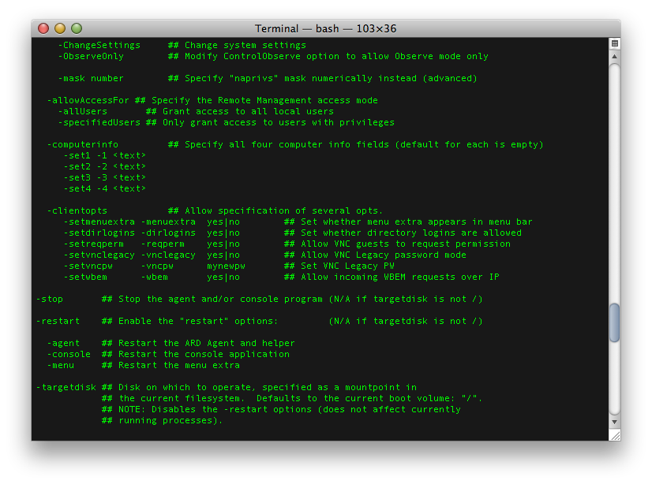
So where do we begin?
Well to start, know that most python programs use what is known as the console
This displays input/output from the user and program
Want to learn how to print things to the console?

Slide 7
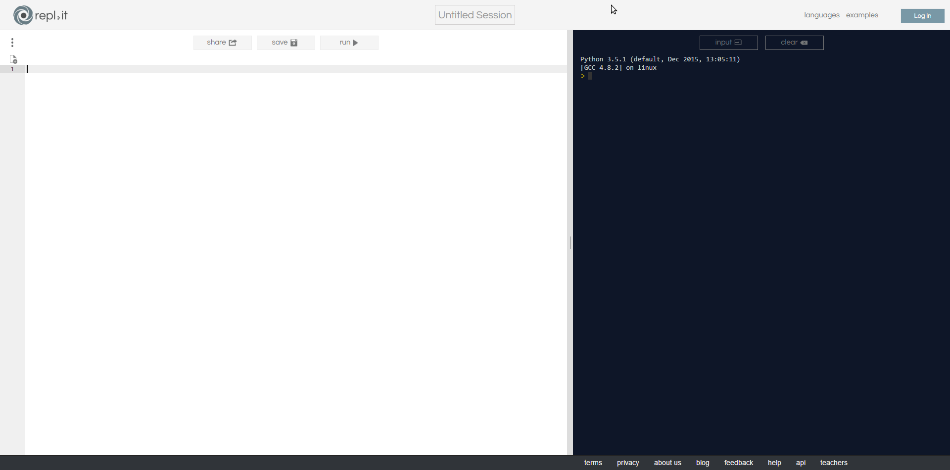
REPL.IT
Goto https://repl.it
Click on ‘Start Coding Now’
Click on Python3
You should see this

Slide 8
Input/Output in the Console
In the left side of repl.it type in
print(“ Your Name Here “)
And replace that with your name but include the “”
Click Run
CONGRATS YOU MADE YOUR FIRST PROGRAM

Slide 9
Input/Output in the Console
Now that you successfully know how to print to the console, let's learn how to get input from the user.
On the left put
name = input(‘What is your name? ’)
print(name)
Run the code, type your name in, and press enter
Name is a variable you made. Variables can be called anything and are used to store values
print() can take most data types and it will print it

Slide 10
Data Types
SWEET YOU CAN PRINT TO THE CONSOLE AND GET THE USER'S INPUT
Now let’s get some more information on variables and other datatypes
Variables can hold all datatypes
Variables are set by doing
varname = data
Words/Sentences are stored in things called strings. This is defined in the code as ‘’ or “”
You can do
Name = “NAME”
Which creates the variable Name and sets “NAME” to it

Slide 11
Data Types
After that you can do print(name) and it will print ‘NAME’
You can also store numbers
Numbers without decimals are called INTEGERS
Numbers with decimals are called FLOATS
To set a number to a variable simply do
weird_number = 2323.234256
This sets the number 2323.234256 to the variable called weird_number
print(weird_number) prints out 2323.234256

Slide 12
Data Types
There are plenty more data types but these are the basic ones.
If you need to convert a string to an integer or float, basically do
Integer = int(string) for integers
OR
Floatnum = float(string) for integers
NOTE that the string must not contain any letters or words, just numbers
Integers cannot be floats, but floats can be integers.
Integers cannot store the decimal points so they are lost

Slide 13
MATH
Want to do some math?
Operators:
+ is the addition operator
- is the subtraction
/ is the division
* is the multiplication
** is squaring the number
How to Use:
2 + 2
Number = 24*24
Value = 6 ** 2

Slide 14
Combining strings
Say you have ‘Franks’ and ‘Bob’ but you want to print ‘FranksBob’
You can simply do
print(‘Franks’ + ‘Bob’)
Or do
print(name1 + name2)
This is called string concatenation, the combination of multiple strings into one

Slide 15
Recap
print() for printing things
input() for getting the user’s input
Variable = data for variables
int(string) for converting the string to a number
float(string) for converting the string to a number with a decimal
MATH ( + - / * )
String conCATonation - print(‘Frank’ + ‘Bob’)

Slide 16
Finale
Make a program using all of the things we have learned here today
You can have it do whatever you want
Show everyone your program next week
MAKE SURE YOU SAVE YOUR CODE ON REPL.IT
Remember you can always read the book that is in our Google Drive
Make sure you use it
You can also ask us any questions on our discord
https://discord.gg/J9BmEDT
Make sure you join :)

